Slide 1



Group 6
Utilizing Modern Portfolio Theory & The Efficient Frontier to Optimize a Portfolio of Assets
Notes:
Justin

Slide 2

01
Portfolio Contents: SPDR ETFs
02
The Key Question: Optimal Weights
Table of
Contents:
03
Demystifying the Efficient Frontier
04
Data Collection, Libraries & Dependencies
05
Exploring the Data: Initial Insights
06
Constructing the Optimal Portfolio
07
Diversifying with New Assets
08
Monte Carlo Simulations
09
Conclusion
Notes:
Justin

Slide 3

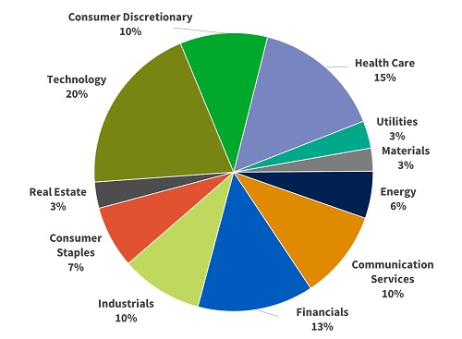
Sector ETF | Ticker
Technology | XLK
Health Care | XLV
Financials | XLF
Real Estate | XLRE
Energy | XLE
Materials | XLB
Communication | XLC
Consumer Discretionary | XLY
Consumer Staples | XLP
Industrials | XLI
Utilities | XLU
11 Sector ETFs of the S&P 500
Source: SeekingAlpha
Notes:
Justin

Slide 4
Sector ETF | Ticker
Technology | XLK
Health Care | XLV
Financials | XLF
Real Estate | XLRE
Energy | XLE
Materials | XLB
Communication | XLC
Consumer Discretionary | XLY
Consumer Staples | XLP
Industrials | XLI
Utilities | XLU
Given a portfolio constructed of the 11 Sector ETFs:
What is the optimal weighting of each Sector ETF within the portfolio that will provide the maximum return, at a given level “x” of risk?
Notes:
Justin

Slide 5
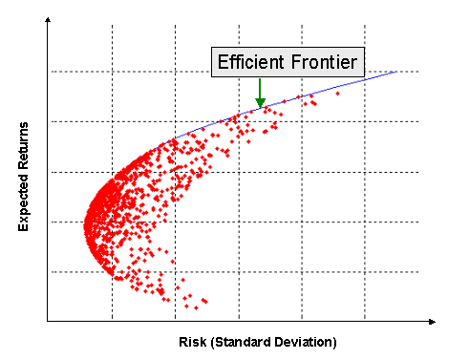
The Efficient Frontier
The Efficient Frontier is a concept from Modern Portfolio Theory that refers to the set of optimal portfolios, or assets within a portfolio, that offer the highest expected return for a given level of risk, or the lowest risk for a given level of expected return.
The optimization strategy is widely used by institutional investors to construct the optimal portfolio.
Source: Investopedia
Notes:
Justin

Slide 6


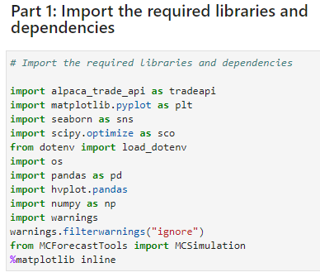
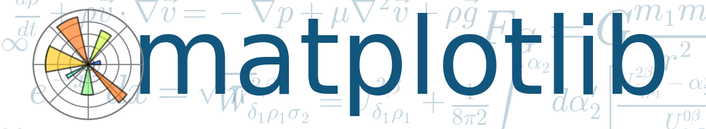




Links : GitHub Repo: https://github.com/justinvalli/Portfolio_Optimization.git
Libraries & Dependencies
Notes:
Kaly

Slide 7

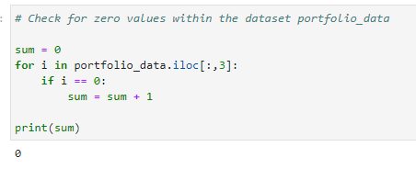
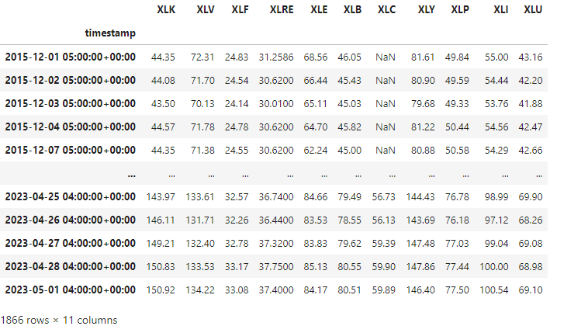
Data Collection & Cleanup Processes
The data is sourced from the ALPACA API to pull closing price historical data from each sector ETF, as well as the novel asset class added to portfolio
10 years of data was pulled into a DataFrame
Then checked for NaN values, as well as zero values
Found that for two ETF’s only had data from 2016 onwards, so we modified the date to reflect accordingly
Removed all unnecessary columns (i.e., open, volume, VWAP)
Concatenated each ETF as a column with close data (using timestamp) as rows
Source: Investopedia
Notes:
Kaly

Slide 8
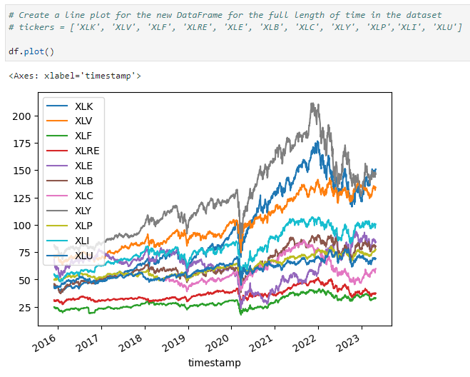
Exploring the Data: Initial Insights
Price action over time provides indication of overall performance of each sector from 2016 to 2023.
All sector ETF appear to be highly correlated to each other.
The uncertain economic times both in 2020 and 2023 are also reflected in the ETF performance thru the large dips.
Source: Alpaca API
Notes:
Will

Slide 9
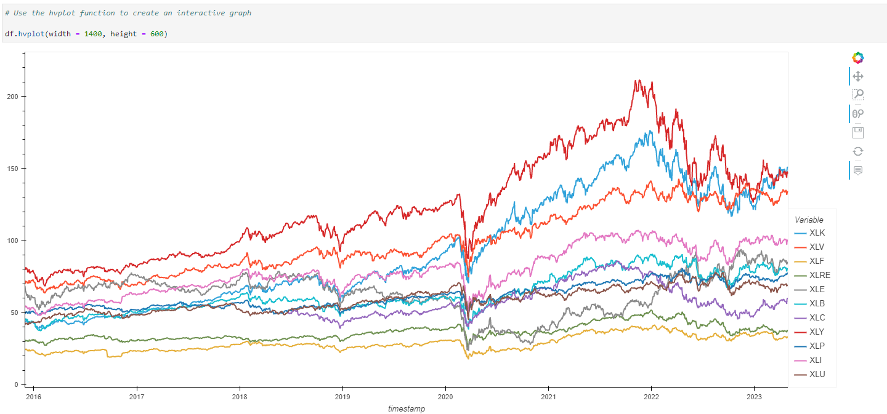
Consumer Discretionary leads the way
Checking the price action shows the aggregate amount that the ETF has gained or lost over time.
Results:
Consumer Discretionary ETF (XLY) had the highest cumulative daily returns
Financial ETF (XLF) had the lowest cumulative daily returns
Source: Alpaca API
Notes:
Will

Slide 10
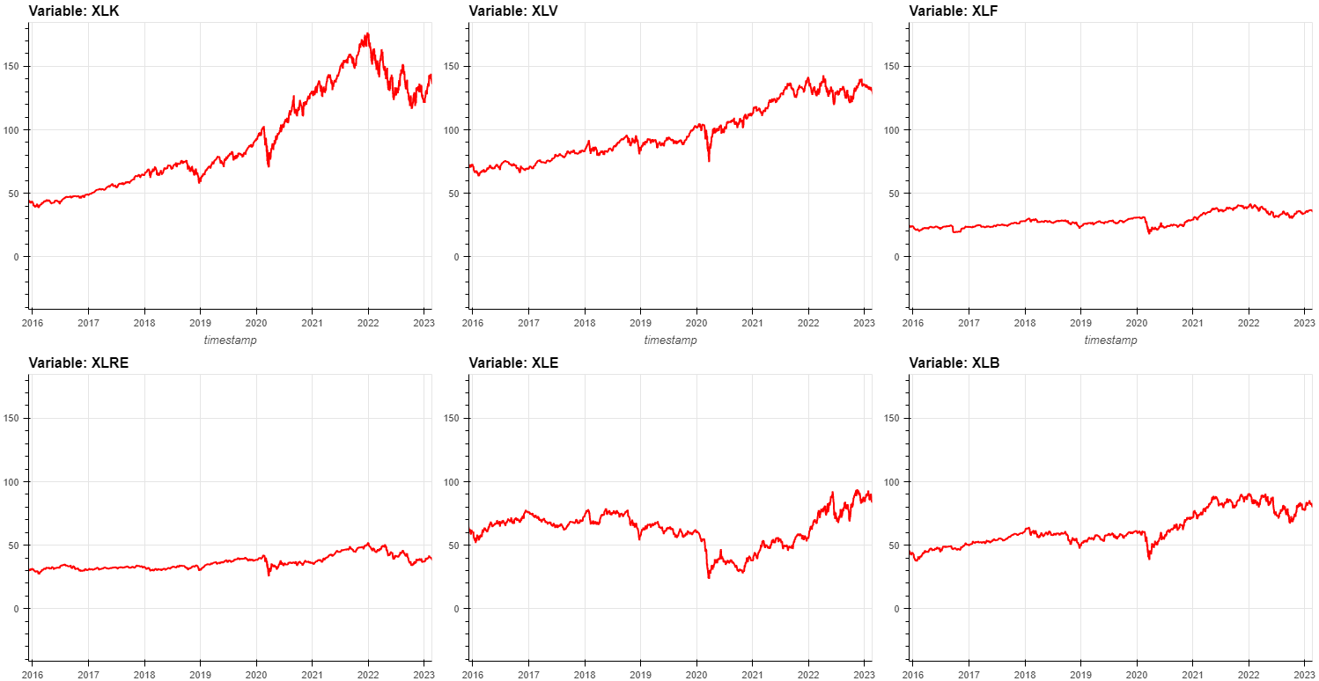
HvPlot Visualizations of Each Sector ETF
Source: Alpaca API
Notes:
Will

Slide 11
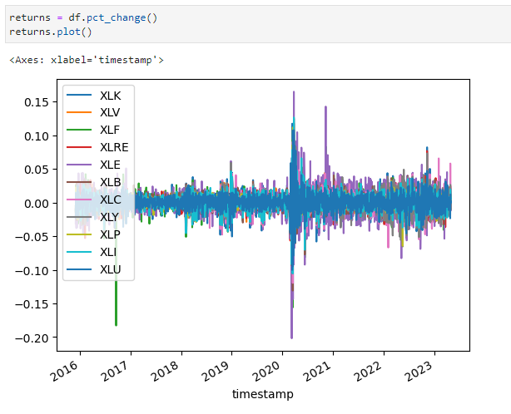
Portfolio Historical Returns
We look at percent change data to have a better idea of volatility within each sector ETF over the time period of 2016 - 2023
The most volatility is present right around 2020 - 2021, due to Coronavirus
The ETFs that showed the most volatility in price over the time period was XLE (Energy) and XLK (Technology) as indicated by the large spike
Source: Alpaca API
Notes:
Will

Slide 12
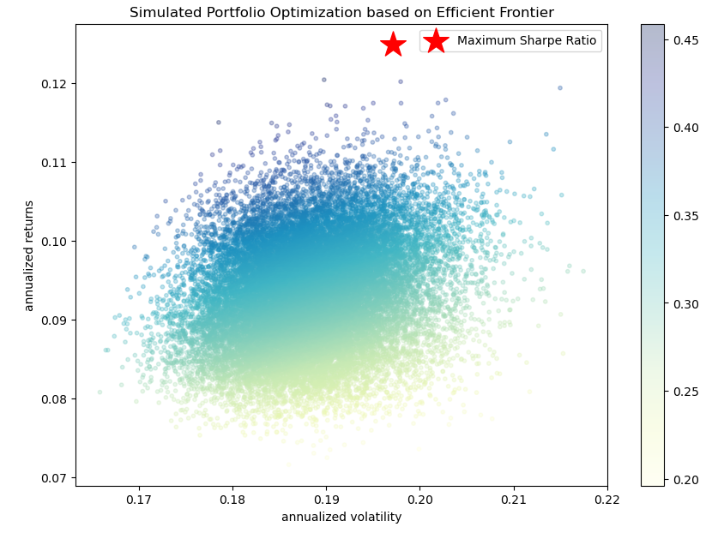
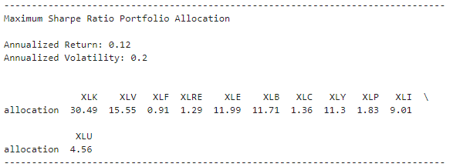
The Optimal Portfolio
Diversifying and optimizing your assets by a weighted allocation can give the maximum return while still being risk averse.
Notes:
Alex - discuss how we got the allocations
Randomize 11 sectors to get the return and volatility, to then get the sharpe ratio
given normal distribution, what would be the maximum return and minimum volatility of the portfolio
how does it differ from having equal weights to each sector?

Slide 13
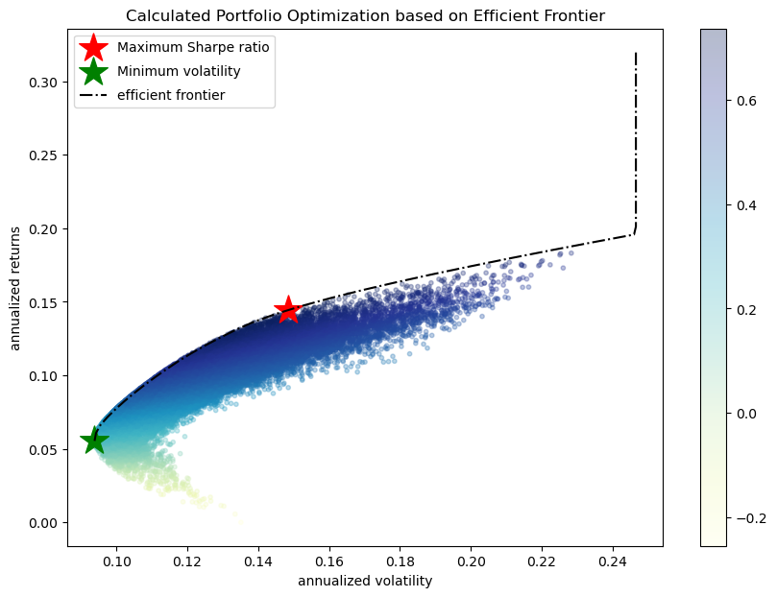
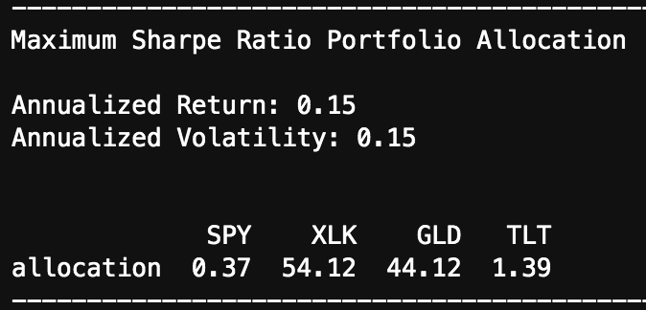
Portfolio 2.0:
What if we tailor our portfolio so that it takes into consideration of hedge inflation assets, value stocks and growth stocks?
Notes:
Alex

Slide 14
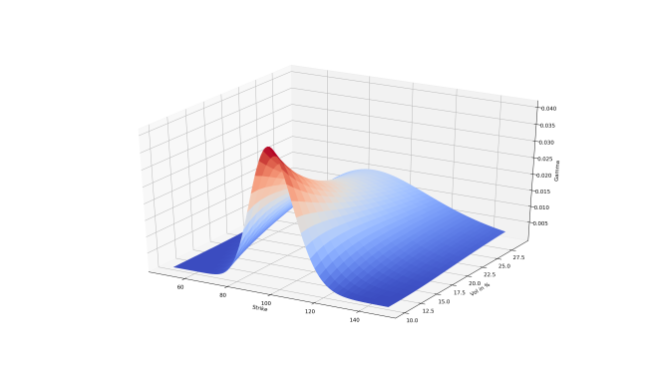
Monte Carlo Simulation:
Used to help with future forecasting by modeling the effects of uncertainty over time
What are the potential profits given $‘x’ of capital and ‘y’ amount of time?
Notes:
Alex

Slide 15
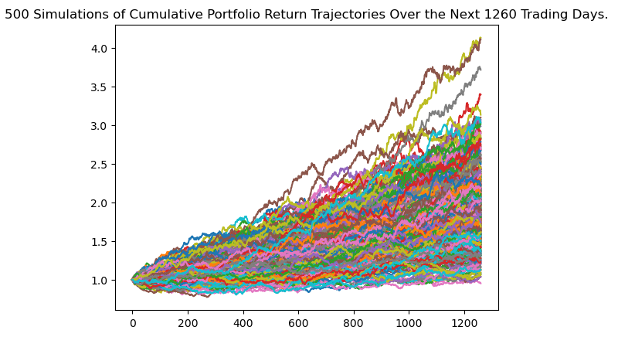
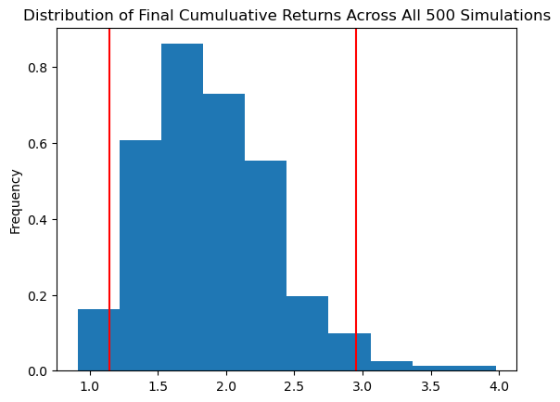
Monte Carlo: Maximum Return
There is a 95% chance that an initial investment of $100,000 in the portfolio over the next 5 years will end within the range of $ 122,036.15 and $ 284,155.59.
Notes:
Alex

Slide 16
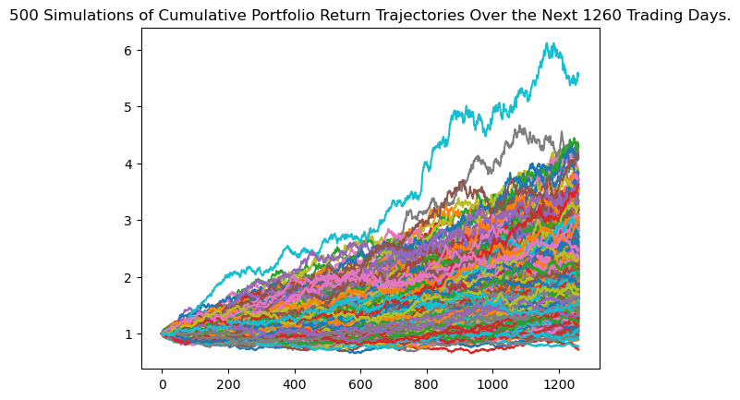
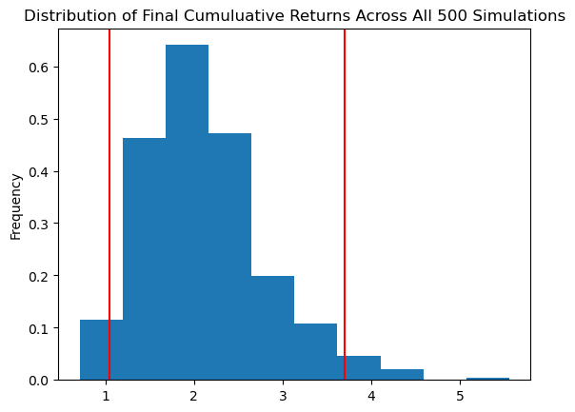
Monte Carlo with Portfolio 2.0
There is a 95% chance that an initial investment of $100,000 in the portfolio over the next 5 years will end within the range of $104,516.35 and $369,288.20.
Notes:
Alex

Slide 17
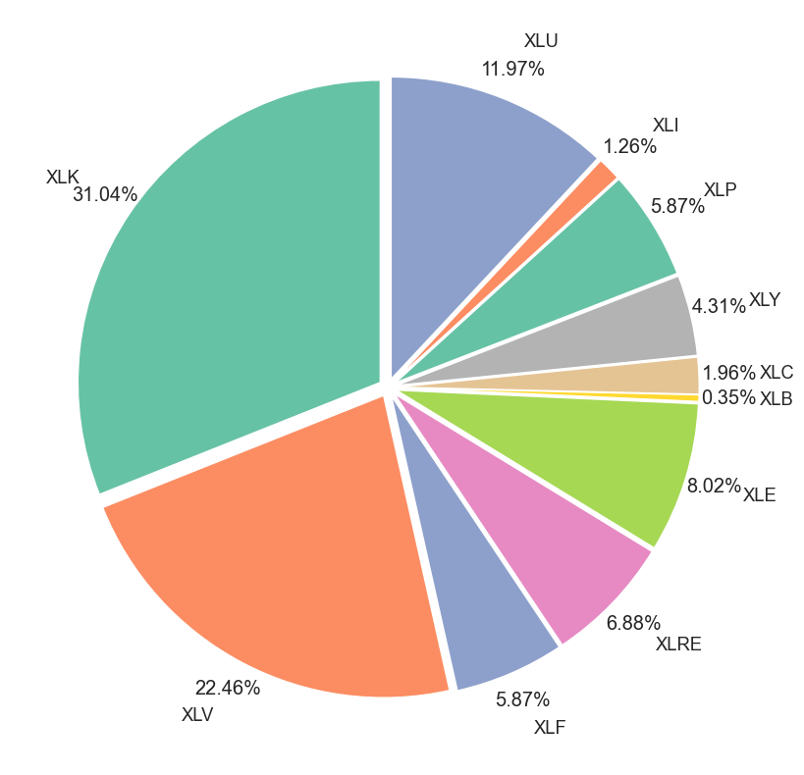
The Optimal Portfolio Construction:
The Key Question: Given a portfolio constructed of the 11 Sector ETFs:
What is the optimal weighting of each Sector ETF within the portfolio that will provide the maximum return, at a given level “x” of risk? How would the addition of a novel asset class affect the risk-return trade off with respect to the portfolio?
Notes:
Justin

Slide 18
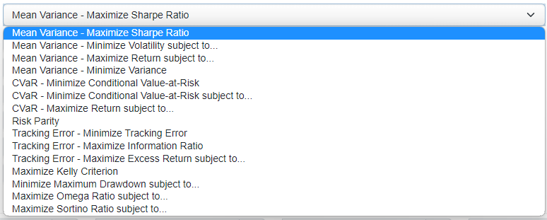
Next Steps:
Exploring different optimization strategies that are superior for more than ten assets within the portfolio
Further diversifying the portfolio with alternative investments like real estate, etc.

Slide 19
Questions?

